Slide 1
Extended Steganography
Group Members:
S.Vivek Roshan(11311A12A8) K.S.S.Murthy(12315A1222)
Y.Sai Krishna(11311A1274)

Slide 2
OUTLINE:
1.Abstract
2.Introduction
3.Existing System
4.Proposed System
5.Procedure
6.Modules an overview
7.Specifications
8.Conclusions and limitations
9.References

Slide 3
abstract
Cryptography is a technique of encrypting and decrypting the information, in such a way that only the intended recipient would know the required keys for the text, to decrypt the data.
Whereas, Steganography is a technique, where we entirely hide the information inside an other, in such a way that only the intended recipient would know the existence of the information.
All the confidential, important information can be hidden inside an other information and can be sent to the valid recipient without facing any threats

Slide 4
Steganography can be done in different ways such as Image Steganography, Audio Steganography, Video Steganography
Image Steganography is widely chosen, because of less memory requirement, wide usage without arising any doubt to the interloper about the data
Extended Steganography is the technique of, combining the Steganography with the cryptography.
Initially the text is encrypted, then hidden inside an image, so even if an intruder retrieve the message from an image, it would be encrypted.

Slide 5
INTRODUCTION:
In the present world, technological development is rapidly seen everywhere.
The impact of the development is becoming a cause for some negative side effects.
The field of communication is the main victim, facing different threats from those negative side effects
One of the different solutions found, in order to face different threats is Steganography.
Steganography is completely different from Cryptography

Slide 6
Steganography is the art of hiding information in other information.
Cryptography is the process of transforming the text into an obscured text, which can be decoded with the help of a key
One of the reasons that intruders can be successful is, the most of the information they acquire from a system is in a form that they can read and comprehend.
One solution to this problem is Steganography, where the important and confidential information is hidden inside an image, in such a way that no one apart from the intended recipient knows the existence of the message

Slide 7
Existing System:
Due to the increase in the cyber crimes, the field of communication has been facing many serious threats.
One of the conventional method for ensuring the threat free communication is cryptography
In cryptography, the message or the text is made obscure, in such a way that it is not understood by any others except the intended recipient.
But, in the present Scenario, with the rapid increase in the development, the ciphered text is also being deciphered.

Slide 8
This type of cyber crimes can be ceased, if we hide the ciphered text in an other information(such as an image ).
So, by hiding the ciphered text in an image, the opponent would never know the existence of the confidential data inside it.

Slide 9
Proposed System
The System under proposal is “Extended Steganography”.
Image Steganography is the process of hiding the information inside an image, so that the confidential information is not exposed to risk
With the help of Steganography, important messages, confidential data can be sent, without exposing the data to the opponent.
It has many applications, For Ex: The major of the army sending the message troop “to attack”.
We can encrypt it, hide the data and can send it over the internet safely.

Slide 10
Procedure:
The Method of Steganography, is achieved by LSB algorithm.
LSB algorithm is the least significant bit algorithm, where the least significant bits of the bytes for the pixels are used to store the information.
8 bits make up a byte, and the right most bit of the byte is called the least significant bit.
As the name indicates, it has the least significance and have a value of 2^0 i.e.. 1.

Slide 11
Hence, embedding the text in these LSB’s would not effect the image .
An image contains many pixels according to its resolution.
Each pixel is associated with its RGB values, where each of it is a 8 bit value. So, each pixel is associated with 3 bytes.
So we can embed 3 bits of our information, in one pixel.

Slide 12
LSB - Example
A sample character of data needs 3 pixels (9 bytes)
00100111 11101001 11001000
00100111 11001000 11101001
11001000 00100111 11101011
00100111 11101000 11001000
00100110 11001000 11101000
11001000 00100111 11101011
Inserting
the binary
value for
A
(10000001)
changes
4 bits

Slide 13
MODULES:
Dealing with the project, the modules involved is,
Cryptographic module.
Steganographic module.
Interface module.
Cryptographic module: This module deals with the encryption and decryption part of the information to be hidden.
Steganographic module: This module deals with the method of hiding the data inside an image and retrieving the stored message from the image

Slide 14
Interface Module: This module works with creating an Interface(GUI), in order to have a user friendly interface.
A user friendly graphical user interface can be created with the help of java swings.

Slide 15
An overview of the project

Slide 16
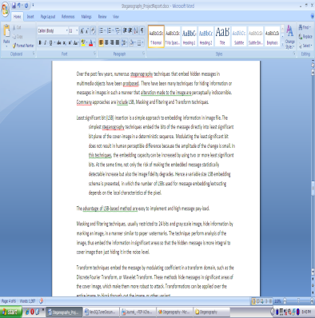
Sender Side: Encryption
Confidential information
Encrypted Information

Slide 17
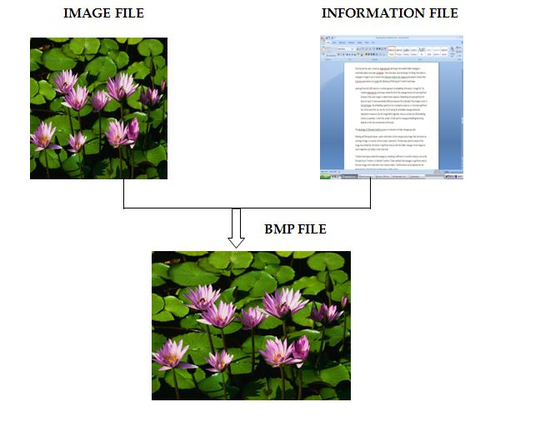
hiding process

Slide 18
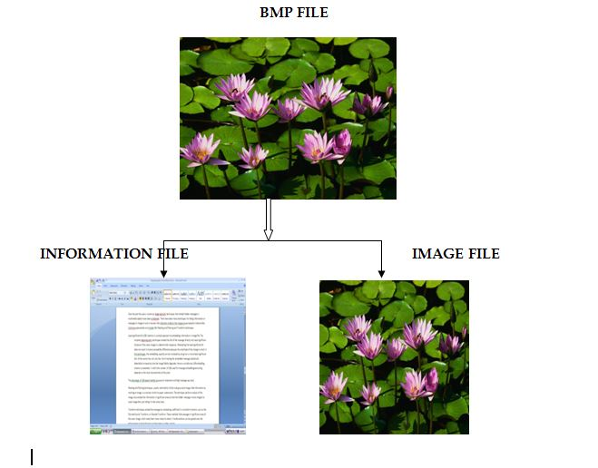
Receiver side: Retrieval process:

Slide 19
decryption
Confidential information
Encrypted Information

Slide 20
Specifications:
Software Requirements:
Operating System: Windows
Java version above 1.5.0
Hardware Requirements:
RAM -1GB
HARD DISK -80GB
PROCESSOR -Intel pentium4

Slide 21
Conclusions:
With the help of Steganography, one can send their confidential data such as passwords etc. without any problem or threat.
Nations important information must be very secretive and must not be exposed to risk
Steganography provides all the requirements for safe communication.
Limitations:
The Size of the image must be considerably big, in order to accommodate the huge data inside it.
A .bmp image, when analyzed with different tools would expose that some chages have been done in an image.

Slide 22
References:
Google.com
http://en.wikipedia.org/wiki/Least_significant_bit
http://en.wikipedia.org/wiki/Steganography

Slide 23
Send Your Data Safe.
Thank You

